Slide 1
4.8 Steganography

Slide 2
Origin and Meaning
Comes from TWO Greek Words
Steganos : covered
Graphein : to write
Steganography : concealed writing
It is a method that attempts to hide the existence of a message or communication
OR
It is art and science of hiding information so that it does not even appear to exist

Slide 3
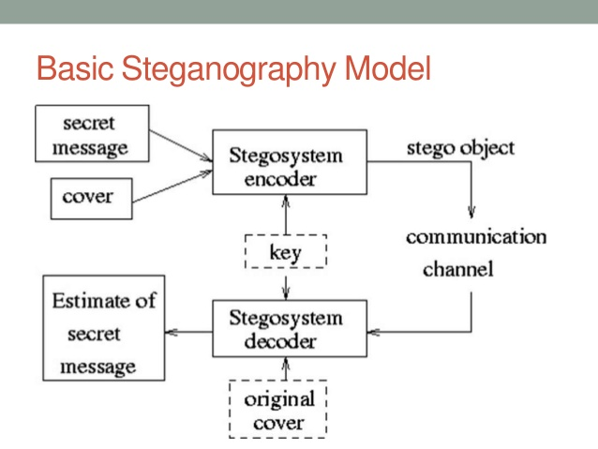
How Steganography Works

Slide 4
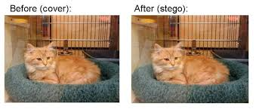
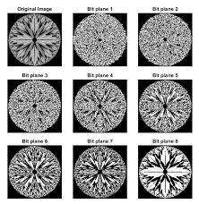
Types of Steganography
Hiding a Message inside Text
Hiding a Message inside Images
Hiding a Message inside Audio and Video Files

Slide 5
Steganography Tools
DiSi-Steganograph
DOS based steganographic program that embeds data in PCX images
Invisible Folders
It ha ability to make any file or folder invisible to anyone using your PC
Stealth Files
It hides any type of file in almost any other type of file(.exe,.dll,.ocs,.com,.jpg,.gif,.mp3,.avi,.doc,.wav,.bmp)
DriveCryptPlus
It allows secure hiding of an entire OS inside free space of another OS
MP3Stego
It hides information in MP3 files

Slide 6
Steganalysis
It is art and science of detecting messages that are hidden in images,audio,video files
It is a couter-measure against Steganography

